Slide 1
Fact or Fiction: Verifying Scientific Claims David Wadden, Shanchuan Lin, Kyle Lo, Lucy Lu Wang, Madeleine van Zuylen, Arman Cohan, Hannaneh Hajishirzi
Presented by
Payel Santra

Slide 2
Goal: Build an automated tool to assist researchers and the public in evaluating the veracity of scientific claim

Slide 3
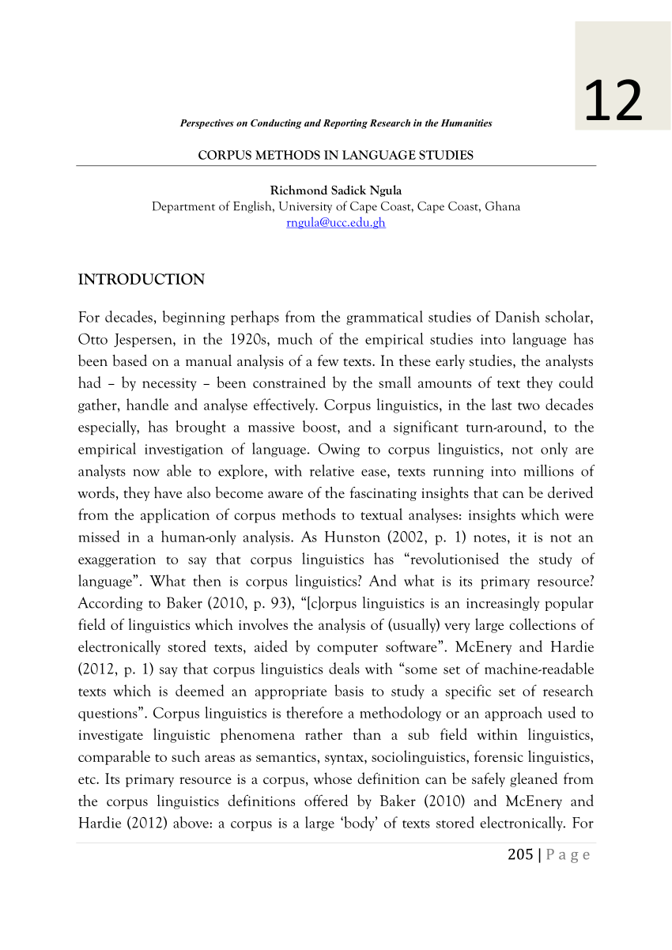

Motivation:
Scientific Claim
Claim Verification
System
Research Corpora
..a $1°$ increase in local temperature reduces transmission by $13\%$...
The coronavirus cannot thrive in warmer climates.
SUPPORTS
..Summer temperature will not substantially limit pandemic growth...
REFUTES

Slide 4
Challenges of Scientific claim verification
Scientific claim
1. Scientific background knowledge
Rationale
ACE-2 receptors are involved in coronavirus infection
Model needs to know:
Baricitinib disrupts ACE-2 function
Patients treated with Baricitinib experienced a reduction (p<0.01) in symptoms.

Slide 5
Challenges of Scientific claim verification
Scientific claim
1. Scientific background knowledge
2. Statistical/ Numerical understanding
Rationale
Rationale
ACE-2 receptors are involved in coronavirus infection
Model needs to know:
P< 0.01 is statistically significant
Patients treated with Baricitinib experienced a reduction (p<0.01) in symptoms.

Slide 6
Challenges of Scientific claim verification
Scientific claim
1. Scientific background knowledge
2. Statistical/ Numerical understanding
3. Long-range context
Rationale
ACE-2 receptors are involved in coronavirus infection
We examine the symptoms of patients with Covid-19
.
.
.
Patients treated with Baricitinib experienced a reduction (p<0.01) in symptoms.
Model needs to know:
The patient has Covid-19 symptoms

Slide 7
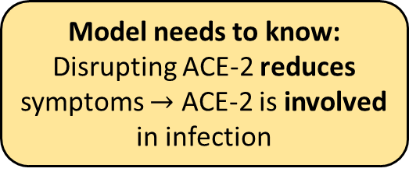
Challenges of Scientific claim verification
Scientific claim
1. Scientific background knowledge
2. Statistical/ Numerical understanding
3. Long-range context
4. cause and effect
Rationale
ACE-2 receptors are involved in coronavirus infection
Patients treated with Baricitinib experienced a reduction (p<0.01) in symptoms.
Model needs to know:
Disrupting ACE-2 reduces symptoms $→$ ACE-2 is involved in infection

Slide 8
Challenges of Scientific claim verification
Scientific claim
1. Scientific background knowledge
2. Statistical/ Numerical understanding
3. Long-range context
4. cause and effect
Rationale
ACE-2 receptors are involved in coronavirus infection
Patients treated with Baricitinib experienced a reduction (p<0.01) in symptoms.
SUPPORTS

Slide 9
Contribution
Construct the SciFact dataset
Define task and develop model
Verify real-world claims

Slide 10
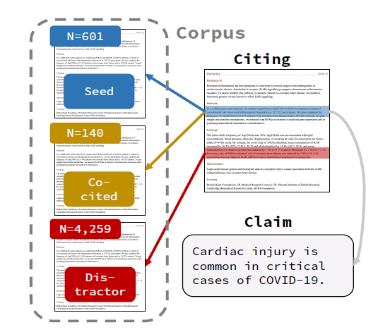
Challenges to dataset construction
Writing interesting scientific claims “from scratch” is difficult for annotators because of lack of domain-knowledge.
To create the dataset, the annotators re-formulate naturally occurring claims in the scientific literature – citation sentences – into atomic scientific claims.
Restrict the articles with at least 10 citations.
Seed set: total resulting collection of articles for all the claims.
Co-cited articles: If some citing articles cite these seed articles,
but not in the seed set.
Distractor abstracts: To expand the corpus, we identify five
papers cited in the same paper as each source citance but in a
different paragraph, and add these to the corpus as distractor
abstracts.

Slide 11
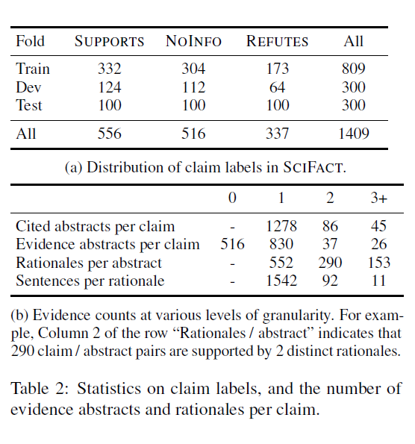
Dataset Statistics

Slide 12

Task Formulation
Input: claim c, a corpus of abstract $𝒜$
The system must predict: a set of evidence abstract $\hat{ε}(c)$,
for each $a∈\hat{ε}(c)$, a label $\hat{y}\left(c,a\right)∈\{Supports, Rufutes,Noinfo\}$
and a collection of rationale sentences $\hat{S}\left(c,a\right)$

Slide 13
VERISCI: Model
Abstract Retrieval
Abstract 1
S1
S2
S3
S4
S5
Abstract 1
S1
S2
S3
S4
S5
SUPPORTS
Claim
Retrieves k top abstracts with highest TF-IDF similarity
Rationale Selection
Label Prediction
Abstract 2
S1
S2
S3
S4
S5
Abstract 2
S1
S2
S3
S4
S5
REFUTES

Slide 14


Rationale Selection
Predict $z_{i}=1[s_{i} is a rational sentence]$ for each $s_{i}$ in a abstract.
To make predictions, we select all sentences with $\tilde{z_{i}}>t$as rationale sentences, where $t∈[0,1]$ is tuned on the dev set
Claim
Rationale
S1
Bert based model
Input:
$$w_{i}=[s_{i,}SEP,c]$$
$$\tilde{z_{i}}=σ[f(CLS(w_{i}))]$$
Non-Rationale
Claim
Abstract 1
S1
S2
S3
S4
S5
.
.
.
.
.
.
Claim
Rationale
S5
Non-Rationale

Slide 15

Label prediction
NoInfo is predicted for abstracts with no rationale sentences
Claim
Bert based model
Input:
$$u=[pred ratinale,SEP,c]$$
$$\tilde{y}(c,a)=φ[f(CLS(u))]$$
Abstract 1
S1
S2
S3
S4
S5
Claim
SUPPORTS
S2
s5
REFUTES

Slide 16
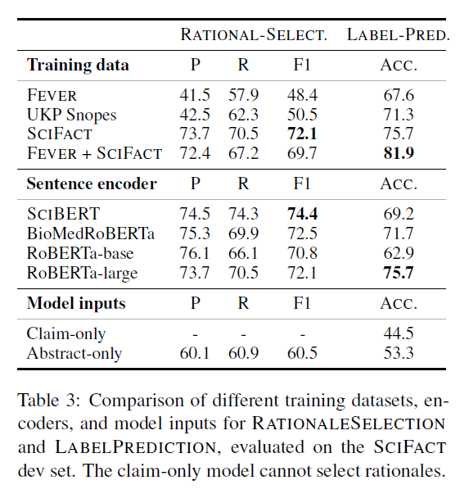
Results
For rationale selection.
SciFact trained model preformed better than
fever trained model,as it missed terms those
contain science-specific vocabulary.
They used Roberta-large for both steps
For abstract retrieval, the best dev set full-
Pipeline performance achieved for top k=3.

Slide 17

Verifying claims about COVID-19
A medical student wrote 36 COVID-related claims.
A pair was labelled plausible if $\hat{ε}\left(c\right)$ was nonempty, and at least half of the evidence abstracts in $\hat{ε}\left(c\right)$ were judged to have reasonable rationales and labels.
For 23 / 36 claims, the response of VERISCI was deemed plausible by the annotators.

Slide 18
Conclusion and Future work
Claim verification allows us to trace the sources and measure the veracity of scientific claims.
This model allows reasonable efficacy on real-world claims related to COVID-19.
For future work that seeks to verify scientific claims against sources other than the research literature – for instance, social media and the news.

Slide 19
Reference:
https://aclanthology.org/2020.emnlp-main.609/

Slide 20
Thank you

